Slide 1
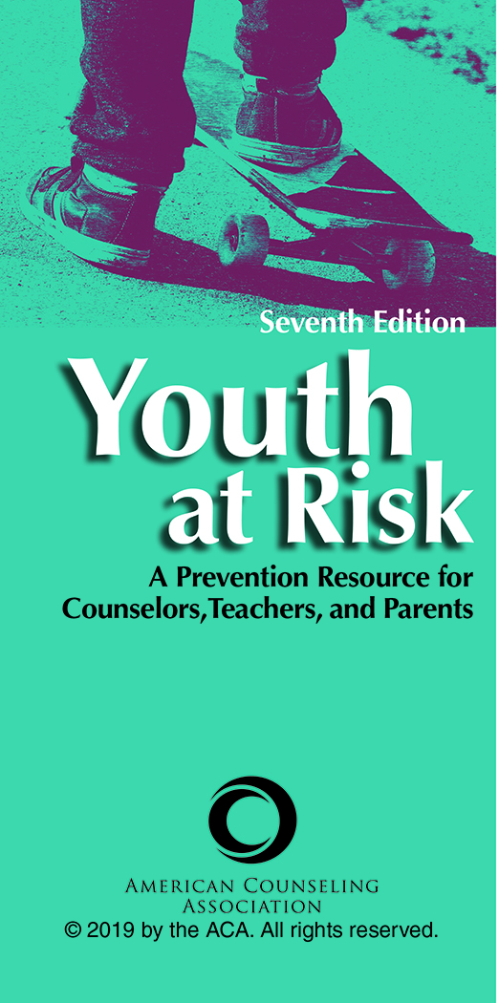
Chapter 9
The Secret and All-Consuming Obsessions: Eating Disorders
Tiffany C. Rush-Wilson
Meredith J. Drew
Ann M. Ordway

Slide 2

Introduction
Eating disorders is the umbrella term for a very complex category of illnesses that can result in severe and even life-threatening consequences.
Eating disorders are the focus of research and academic attention devoted to uncovering their unique composition of biological, psychiatric, sociopolitical, environmental, and cultural variables.

Slide 3
Introduction
Although everyone must eat to live, social value is often placed on the degree to which people look nourished.
Eating practices are associated with strength, unhealthy indulgence, and misguided elitism.
For these reasons, it is not surprising that some people struggle with their relationship to food.

Slide 4
Introduction
This body image pursuit emphasizes control and discipline over self-indulgence.
The idealized body type that is portrayed in advertising is naturally possessed by only 5% of American women.
By age 6, girls especially start to express concerns about their own weight or shape. Also, 40% to 60% of elementary school girls (ages 6–12) are concerned about their weight or about becoming too fat.

Slide 5
Introduction
A review of nearly 50 years of research confirms that anorexia nervosa (AN) has the highest mortality rate of any psychiatric disorder.
Many who suffer from an eating disorder have compounding and resultant relationship, financial, and productivity struggles and comorbidity with other psychiatric disorders.

Slide 6
Types of Eating Disorders
AN
The word anorexia is derived from the Latin and means “lack of hunger.”
When combined with nervosa (or “due to nerves”), it describes a clinical condition composed of several symptoms, including intentional, restrictive eating patterns and low body weight.

Slide 7
Types of Eating Disorders
Bulimia Nervosa (BN)
This eating disorder was separated from AN as a unique diagnosis in 1987.
People who have BN ingest large quantities of food and rid the body of the food using unhealthy, compensatory means, such as intentional vomiting, misuse of laxatives, or excessive exercise.

Slide 8
Types of Eating Disorders
Binge-Eating Disorder (BED)
This eating disorder was first identified in the late 1950s.
It is defined by ingesting large quantities of food in a discrete time period without engaging in compensatory (elimination) behaviors.
This eating behavior is associated with emotional distress and feeling as if the person has no control over his or her eating.

Slide 9
Types of Eating Disorders
Additional Noteworthy Subclinical and Unofficial Diagnoses
Pica
Avoidant Restrictive Food Intake Disorder
Rumination Disorder
Atypical AN
BED
Purging Disorder
Night Eating Syndrome
Diabulimia
Drunkorexia

Slide 10
Risk Factors
Findings from current research increasingly support the view that susceptibility to eating disorders may not be related only to demographics but may be more strongly related to a person’s experiences and coping skills.
It is common for people who have eating disorders to have a history that includes exposure to and perceptions of endured trauma.

Slide 11
Risk Factors
Gender
Until recently, eating disorders were thought to be a female disorder.
Although female gender does still remain a risk factor for developing an eating disorder, eating disorders and body image struggles affect both genders.
In general, mainstream television viewing has been found to be related to poorer body image.

Slide 12
Risk Factors
Gender
An overfocus on weight and body type has a direct impact on youth and disordered eating. It is estimated that more than half of teenage girls and one third of teenage boys use unhealthy methods to control their weight.
Although both adolescent girls and boys may be susceptible, disordered eating may manifest differently by gender.

Slide 13
Risk Factors
Gender
It was previously accepted that sexual orientation was a strong predictor of disorders in men. It is now known that men of various sexual orientations are affected by eating disorders.
Men and boys present with approximately 5% to 10% of the cases of AN and BN, whereas women and girls present with the larger majority of the total presenting cases.

Slide 14
Risk Factors
Age
Research findings indicate that disordered eating behavior is strongly associated with coping with emotional trauma that can occur throughout the life span. Therefore, no age group, from young children to older adults, is immune.

Slide 15
Risk Factors
Race and Ethnicity
Anorexia and bulimia have historically been associated with upper-middle-class White female populations. However, their risk and prevalence are increasing among minority groups.
Culture may also influence the prevalence of specific eating disorder symptoms.

Slide 16
Risk Factors
Socioeconomic Status
Women with anorexia and bulimia have historically most frequently come from the middle to upper-middle socioeconomic class.
Exposure to trauma, as previously mentioned, has been identified as a significant risk factor in the etiology of eating disorders among people regardless of socioeconomic status.

Slide 17
Risk Factors
Family Characteristics and Influences
Despite variations in the opinions of researchers as to the specific role family plays in the emergence of eating disorders, there is a clear consensus that familial influence is prevalent.
Some researchers have also linked the development of eating disorders to parent–child relationships and attachment.

Slide 18
Problem Identification
Until May 2013, BN and AN were specified in the Diagnostic and Statistical Manual of Mental Disorders (4th ed., text rev.; DSM-IV-TR; American Psychiatric Association, 2000) along with the heterogeneous, catch-all category of eating disorder not otherwise specified.

Slide 19
Problem Identification
In 2013, the newly revised fifth edition of the DSM added BED. The category eating disorder not otherwise specified was changed to feeding and eating disorders not elsewhere classified and now includes subthreshold BN and atypical AN as well as subthreshold BED, and purging disorder.

Slide 20
Problem Identification
AN
The prevalence of AN is approximately 0.4% among young females. The prevalence rate for males is less well known, but it is known that the rate for females is significantly greater than that for males.
Approximately 90% of reported cases of AN are of female patients, although cases of male patients are on the rise. Despite this rising rate, there is still limited information regarding diagnosis and treatment of males.

Slide 21
Problem Identification
AN Diagnostic Criteria
Persistent restriction of energy intake leading to significantly low body weight
An intense fear either of gaining weight or of becoming fat
Disturbance in the way one's body weight or shape is experienced

Slide 22
Problem Identification
AN Diagnostic Criteria
The DSM-IV-TR specified two types of anorexia:
    Restricting Type
    Binge-Eating/Purging Type
    One of the first noticeable symptoms of anorexia is a preoccupation with food, particularly a focus on the fat, carbohydrate, and calorie content of food.

Slide 23
Problem Identification
BN
Prevalence estimates for BN vary, but approximately 1% to 5% of the population will be diagnosed.
Prevalence statistics may be low because most teenage girls with BN do not seek treatment.
Surprisingly, a study conducted with 1,100 participants found that men accounted for 25% of bulimia cases.

Slide 24
Problem Identification
BN
BN is a disorder characterized by cyclical periods of binge eating followed by purging behavior (vomiting, laxative use, diuretic use, or excessive exercising).
Many individuals engage in purging behavior without a precursor binge.
Approximately 35% to 57% of adolescent girls engage in crash dieting, fasting, self-induced vomiting, diet pill use, or laxative use.

Slide 25
Problem Identification
BN
The diagnostic criteria of the DSM-IV-TR (American Psychiatric Association, 2000) specified two types of bulimia:
  Purging Type
  Non-Purging Type

Slide 26
Problem Identification
BN Diagnostic Criteria
Eating, in a discrete period of time (e.g., within any 2-hour period), an amount of food that is definitely larger than most people would eat during a similar period of time and under similar circumstances
A sense of lack of control over eating during the episode (e.g., a feeling that one cannot stop eating or control what or how much one is eating)

Slide 27
Problem Identification
BN Diagnostic Criteria
Recurrent inappropriate compensatory behavior to prevent weight gain
The binge eating and inappropriate compensatory behaviors both occur on average at least once a week for 3 months.
Self-evaluation is unduly influenced by body shape and weight.
The disturbance does not occur exclusively during episodes of AN.

Slide 28
Problem Identification
BED
Research has estimated that approximately 1.6% of adult females and 0.8% of adult males develop BED.
BED is characterized by binge eating (eating a large amount of food in a short period of time) with the absence of regular inappropriate compensatory behaviors (e.g., vomiting) that are characteristic of BN.

Slide 29
Problem Identification
BED Diagnostic Criteria
    Eating, in a discrete period (e.g., within any 2-hour period), an amount of food that is larger than most people would eat during a similar period and under similar circumstances
A sense of lack of control over eating during the episode

Slide 30
Problem Identification
BED Diagnostic Criteria
The binge-eating episodes are associated with three or more of the following:
    Eating much more rapidly than normal
    Eating until feeling uncomfortably full
    Eating large amounts of food when not feeling physically hungry

Slide 31
Problem Identification
BED Diagnostic Criteria
The binge-eating episodes are associated with three or more of the following:
    Eating alone because of feeling embarrassed by how much one is eating
    Feeling disgusted with oneself, depressed, or very guilty afterward

Slide 32
Problem Identification
BED Diagnostic Criteria
Marked distress regarding binge eating is present.
Binge eating occurs on average at least once a week for 3 months.
Binge eating is not associated with the recurrent use of inappropriate compensatory behaviors as in BN and does not occur exclusively during the course of BN or AN.

Slide 33
Problem Identification
Other Specified Feeding or Eating Disorder
The category other specified feeding or eating disorder includes
Atypical AN, BN of low frequency and/or limited duration, BED of low frequency and/or limited duration, purging disorder, and night eating syndrome

Slide 34
Approaches to Prevention
Successful primary prevention curtails the development of eating disorders in unaffected individuals.
Secondary prevention detects early warning signs of eating disorders and encourages treatment for those in the early stages of the disorders.

Slide 35
Approaches to Prevention
Individual Approaches
Education programming is the most common approach to preventing eating disorders at the individual level.
To combat lookism and weightism, high school programs increase media literacy and critical thinking to dispel the media myths about women for greater body acceptance.

Slide 36
Approaches to Prevention
Individual Approaches
Secondary prevention focuses on warning signs and confrontation skills.
Friends and family members take an active role in identifying and communicating about disordered eating.

Slide 37
Approaches to Prevention
Family Approaches
The role of the family in the prevention of eating disorders and disordered eating is crucial and has received strong research support.
Avoiding the maladaptive dynamics that contribute to eating pathology would be prudent for family members.

Slide 38
Approaches to Prevention
Family Approaches
Eight recommendations for parents to prevent eating disorders in their children
  Enhance parent support
  Decrease talk about weight and body
  Provide a supportive home food environment
  Model healthy eating habits
  Help children build self-esteem
  Encourage appropriate expression of feeling
  Increase parental understanding of eating disorders
  Gain support in dealing with struggles as a parent

Slide 39
Approaches to Prevention
School Approaches
Elementary, middle, and high school personnel must spearhead prevention efforts and the early detection of eating disorders among adolescents.
Most prevention programs target the student, which is needed, but it is also important to educate teachers and staff. Programs that target the whole school and reach out to the larger community are highly effective.

Slide 40
Approaches to Prevention
School Approaches
Body Project, a selective dissonance-based eating disorder prevention program, has shown support at the high school level when counselors recruit youth with body image concerns to critique the thin ideal in written, verbal, and behavioral exercises.

Slide 41
Approaches to Prevention
Community Approaches
At present, community prevention is minimal.
Studies have measured a decrease in disordered eating behavior among participants when media was reduced and community prevention programs educated participants regarding idealized images.
Researchers are becoming more creative in prevention efforts, for example, by turning to internet-based prevention programs.

Slide 42
Intervention Strategies
Individual Strategies
Individual interventions vary depending on the theoretical approach used in conceptualization; however, there are some central unifying principles.
There is usually an initial consideration regarding the medical stability of the client. Consultation with a physician is essential during the assessment phase. The medical complications arising from anorexia, bulimia, and binge eating are dangerous; thus, it is imperative to monitor the client’s physical condition.

Slide 43
Intervention Strategies
Individual Strategies
Another consideration is the need for nutritional restabilization.
Without adequate nutrition, counseling will be less effective because of the cognitive and affective disturbances that result from starvation and/or bingeing.

Slide 44
Intervention Strategies
Individual Approaches
  Individual Counseling
  Group Counseling
  Inpatient Treatment
  Pharmacological Treatment
  Internet Resources

Slide 45
Intervention Strategies
Family Approaches
Family Counseling
  Common issues in these families are enmeshment, overprotection, hostility, and rigidity.
  Goals of family counseling generally address communication, support, distorted thinking, responsibility, and the reestablishment of boundaries.

Slide 46
Intervention Strategies
School Approaches
Although few school counselors are trained in the treatment of eating disorders, it may be up to the school to first identify disturbed eating patterns.
  School personnel should be aware of eating disorder signs and symptoms.
  Resources and referrals that are available to students seeking treatment should be current.

Slide 47
Intervention Strategies
Community Approaches
Community interventions are minimal.
  Perhaps because of the perceived rarity of these disorders, wide-scale community interventions are not practiced.
  Another possible reason for the lack of community-level intervention is the inherent challenge of the societal standards of beauty and appearance.

