Slide 1
Family Counseling
Torey L. Portrie-Bethke, PhD, NCC

Slide 2
Family Systems
Define family.
How are families viewed in the American culture?
What influences your roles within your family/families?
How has the counseling program changed your role within your current relationships?
Describe family values that are important to you.
Notes:
Family Systems:
Blended Families, nuclear families, single parent families, gay & lesbian families, grandparent families, sibling families, adopted families, biracial families,
Ask the students in dyads to define family in their own words. Compare the varying definitions and explore the common themes and differences within the responses.

Slide 3
Family Life Cycle
Stages
Leaving home: single young adults
Joining of families through marriage: the new couple
Families with young children
Launching children and moving on
Families in later life
  Carter & McGoldrick, 1999

Slide 4



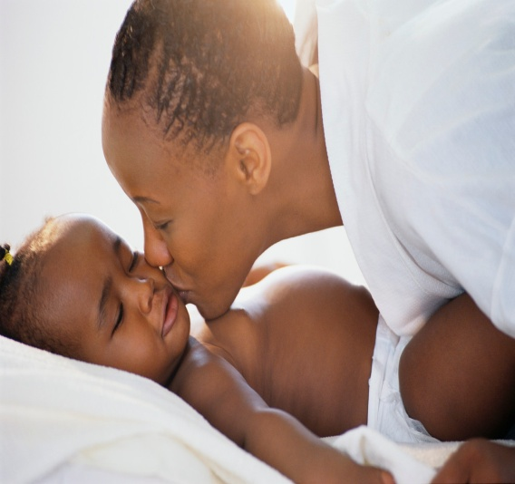
Families with young children
Infancy to preschool
Middle to childhood
Adolescence
  Carter & McGoldrick, 1999
Notes:
Infancy to preschool:
Task: Attachment to care giver, Language development, Differentiation to self and environment, Self-control and compliance
Middle Childhood:
Task: School adjustment (attendance, appropriate conduct, social development, identifies difference between learning experiences)
Academic Achievement (leaning to read, following homework directions, math)
Getting along with peers (acceptance, making friends)
Rule-governed conduct (following rules of the society for moral behavior and personal conduct)
Developing an understanding of social status
Adolescence:
Task: Successful transition to secondary schooling
Academic achievement: learning skills for higher education or work)
Involvement in Extra curricular activities (clubs, sports, band)
Forming close friendships within and across genders
Forming a cohesive sense of self: identity
Masten & Coatsworth, 1998

Slide 5



Stages of the Family Life Cycle
Leaving home: single young adults
  What are the primary experiences of a young adult?
  What are the responsibilities of a young adult?

Slide 6




Family Life Cycle Stage
The joining of families through marriage: the new couple
  Identify challenges new couples experience.
  Identify responsibilities of new couples.
Notes:
Emotional Process of transition: Key Principles
Commitment to new system and all relationships in that system
Developing roles within the new marital system and other relationships as a married couple
realignment of relationships with extended family and friends to include spouse /partner

Slide 7


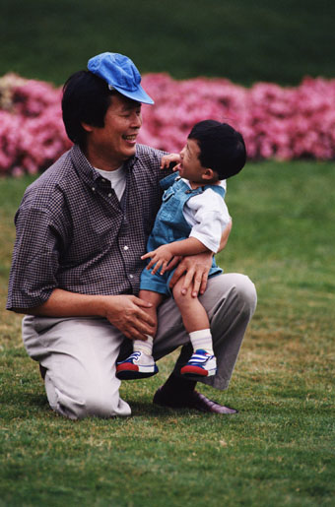
Family Life Cycle Stage
Families with young children:
  What changes may a couple experience when having, adopting, or blending new children into the relationship?
  Describe how daily activities change with young children.

Slide 8


Family Life Cycle Stage
Families with Adolescents:
  What challenges do you perceive the families and teenagers experience?
  Describe daily activities of a family with adolescents.
Notes:
Families with Adolescents:
Emotional process of transitional: Key Concepts
Increasing flexibility of family boundaries to permit
Children’s independence and grandparents frailties.
Second order change in family status: Required to proceed developmentally:
Shifting of parent child-relationship to permit adolescent to move into and out of system.
Refocusing on midlife and career issues
Beginning to shift and care for older generations.

Slide 9



Family Life Cycle Stage
Launching children and moving on:
  As parents, what new experience may they be experiencing?
  As a couple, what new struggles and joys may take place?
Notes:
Accepting exist and entrances into the family system.
Renegotiating family system as a dyad.
Developing adult to adult relationships.
Developing new relationships with adult children.
Dealing with disabilities and loss of parents

Slide 10

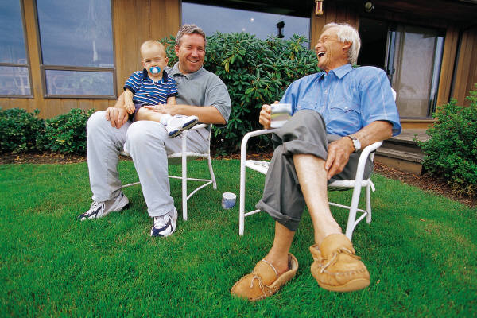
Family Life Cycle Stage
Families in later life:
  What physical and emotional changes may take place?
  How does personal responsibility change?
Notes:
Accepting the shift in generational roles
Maintaining own and couple functioning and interests as physiological decline is experienced.
Needing support for younger generation.
Dealing with loss of spouse, siblings, friends, and other losses.

Slide 11
Reference
Carter, B., & McGoldrick, M. (Eds.).
  (1999). The expanded family life cycle: Individual, family, and social perspectives (3rd ed.). Needham Heights, MA: Allyn & Bacon.

